Slide 1
Elevator Interface Design
By Kennet Thurman
CS 3366 – HW 1

Slide 2
Elevator Applications
Common Use:
Moving people or freight vertically
Rare Use:
Move large animals within a building
Common Elevator Interfaces:
Buttons on the exterior of the elevator provide options to go up or down
Buttons in the elevator typically allow the user to select a floor to travel to, open and close the doors, and call for help
Feedback:
Elevator buttons light up when pressed
Indicators above elevator show which floor it is on
Bell dings when the elevator reaches desired floor
Common Mistakes:
Getting in an occupied elevator that is not going in the users intended direction
Pressing the wrong floor number

Slide 3
Example
Generally acceptable design
Two buttons: alert and call for help?
Fan? Lights? Off/On?

Slide 4

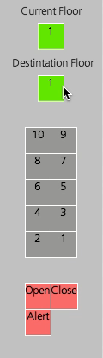
My Processing Elevator Design
Current and destination floor indicators
Floor numbers listed from largest to smallest
Functional buttons for special use
Project sources:
Interfascia – GUI creator
ttslib – text to speech
Processing - IDE

Slide 5
Questions?

